Slide 1

proposed model by
McCulloch and Pitts
b) augmentation with
binary weight vector
c) array of augmented
McCulloch-Pitts neurons
W
v₁
w
v₂
_
s
v
s
V
s
-
-
-
-
-
v₃
e
s
e
s
E
s
. . .
v_{l}
v_{i} , s∈ {0,1}
v,w,e∈ {0,1}^{l}, s∈ {0,1}
V,W,E∈ {0,1}^{d x l}, s ∈ {0,1}^{l}
_
-
-
e = e(v₁, v₂, ... ,v_{l} ) = v_{i}
e = e(v,w) = w ° v
E = E(V,W) = W ° V ∈ {0,1} ^{d x l}
-
-
-
s = s(e) = (e ≥ Θ )
s = s(e) = ( e ≥ Θ )
s = s(E) = [ e_{i} ≥ Θ ]

Slide 2
W
v₁
w
v₂
_
s
v
s
V
s
-
-
-
-
-
v₃
e
s
e
s
E
s
. . .
v_{l}
proposed model by
McCulloch and Pitts
b) detector
c) detector set

Slide 3
v₁
v_{i}∈ {0,1}
v_{i}∈ {0,1}
v₂
s∈ {0,1}
v∈ {0,1}
s∈ {0,1}
v₃
g
f
G
f
. . .
v_{n}
e = g(v₁, v₂, ... ,v_{n}) = v_{i}
K,
y = f(e) = (s ≥ η)
c∈ {0,1}^{L}
s∈ {0,1}

Slide 4
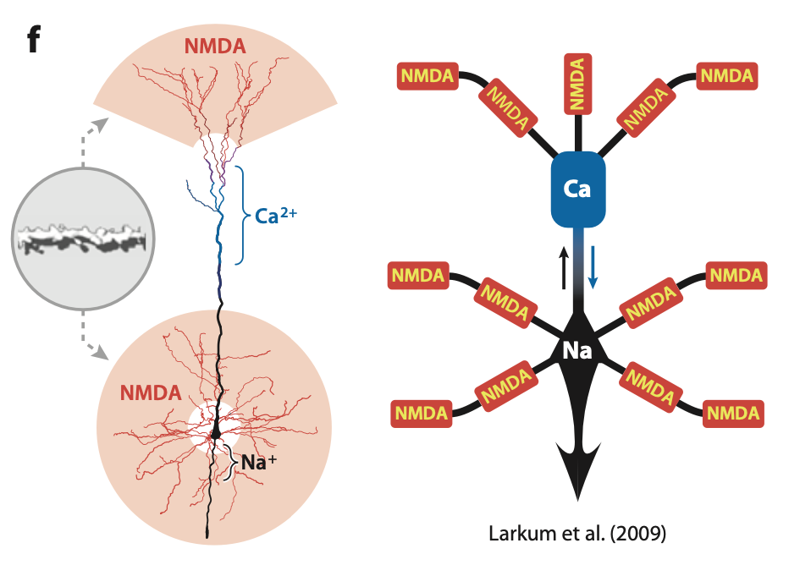

Slide 5







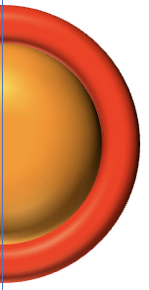


Slide 6
excited
(u = 1)
active
(y = 1)
predictive
(p = 1)
depressed
(d = 1)
excited &
predictive & active
(u = 1, p = 1, y = 1)
excited & depressed
(u = 1, d = 1)
excited & active
(u = 1, y = 1)

Slide 7
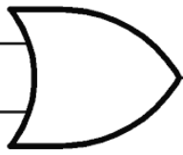


excited
(u = 1)
active
(y = 1)
predictive
(p = 1)
depressed
(d = 1)
p
u
y
y = u ° p + ° (not d)
$$\hat{u}$$
$$\hat{u}$$
d
fundamental Neurotron relation

Slide 8

active (y = 1)
stimulated (u = 1)
excited (q = 1)
depressed (d = 1)
bursting (b = 1)
predictive (x = 1)
Neurotron core logic
b
d
$$q$$
P
q = Q (u)
Q
y
u
b = P (q ° not d)
x
y = u ° x or b

Slide 9


W_{p}
p
V
prediction
terminal
w_{u}
{
y
f
excitation
terminal
u
w_{d}
$$\hat{u}$$
{
v
depression
terminal
d

Slide 10
w_{u}
f
b
excitation
terminal
y
q
w_{d}
2
1
0
depression
terminal
u
0
4
3
W_{p}
x
1
7
0
y
c
p
prediction
terminal

Slide 11
w_{d}
c
d
depression
terminal
b
q
0
2
3
w_{e}
2
1
0
f
u
y
excitation
terminal
0
4
3
proximal
y
y
W_{p}
c
s
x
prediction
terminal
0
1
6
1
8
0
distal
soma

Slide 12
w_{d}
c
d
depression
terminal
b
q
0
2
3
w_{e}
2
1
0
f
u
y
excitation
terminal
0
4
4
y
y
proximal
W_{p}
1
8
0
x
c
s
prediction
terminal
distal
soma

Slide 13
w_{d}
c
d
depression
terminal
b
q
0
2
3
w_{e}
2
1
0
f
u
y
excitation
terminal
0
4
4
y
y
proximal
W_{p}
1
8
0
x
c
s
prediction
terminal
distal
soma

Slide 14
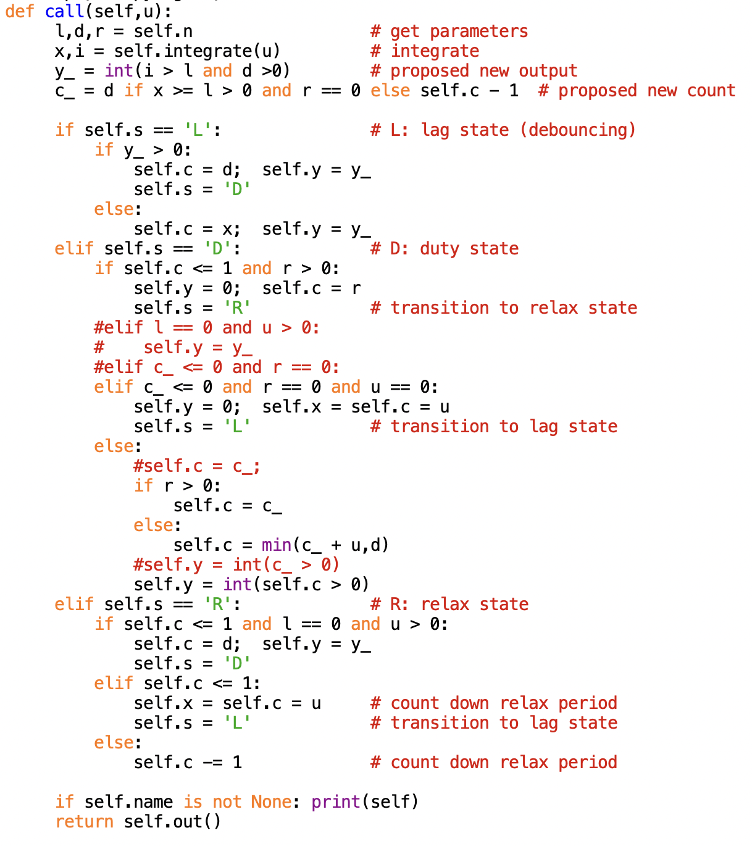
else :
s
∈ {LAG, DUTY, RELAX}
c = min(c‘ + u, d)
if r > 0 :
c = c‘
DUTY
if c ≤ 1 & r > 0:
c = r, y = 0
y
if y‘ > 0:
if c‘ ≤ 0 & r=u=0:
else :
RELAX
c = d, y = y‘
c = x = u, y = 0
c = c-1
if c ≤ 1 & l=0 & u>0:
c = d, y = y‘
LAG
else:
c = x, y = y‘

Slide 15
−1
u
Σ
i
y’
2
i > l & d > 0?
y
State: (s, x, c)
Parameters:
l: lag
d: duty
r: relax
l
c
c
x(t) = x’(t-1)
l
x
x’
if x ≥ l > 0 & r=0:
c’ = d
else: c’ = c - 1
c’
x

Slide 16
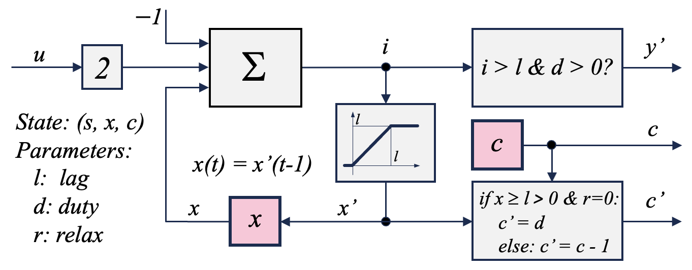
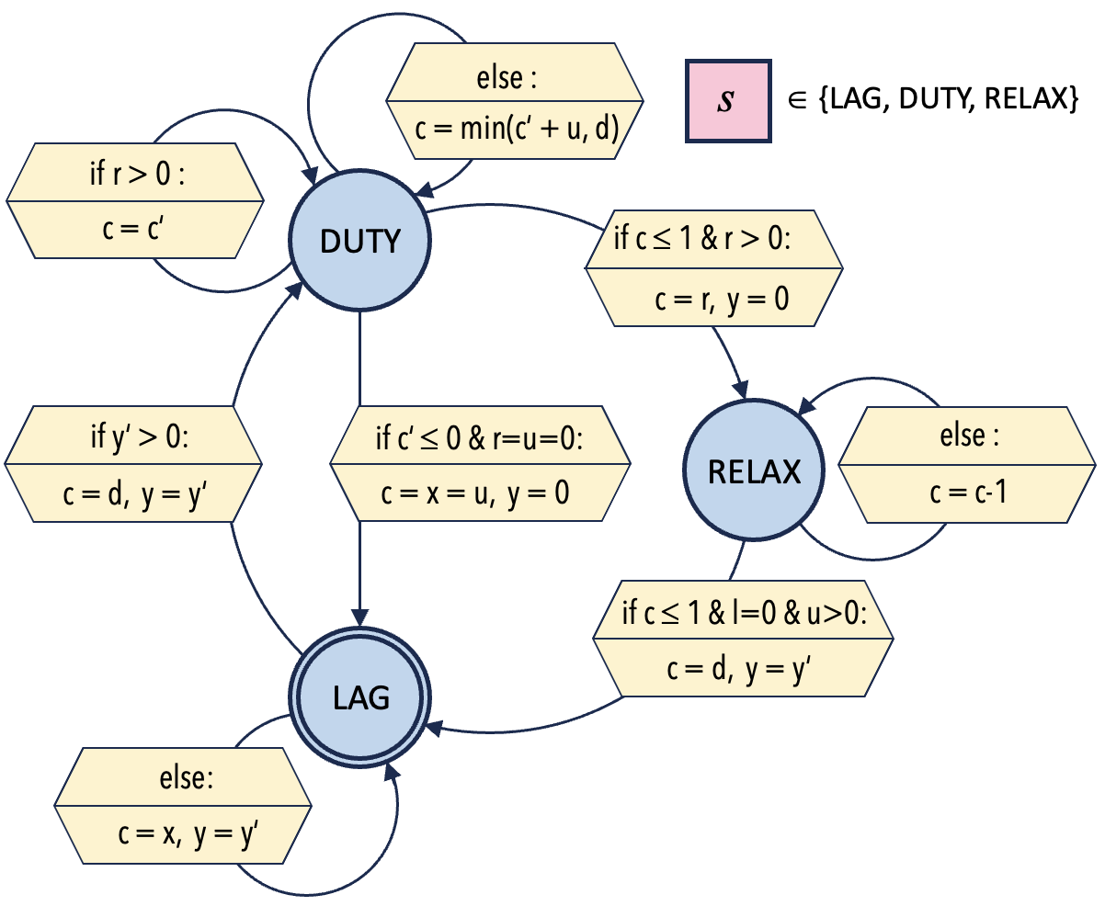
y
u
l
d
r
y

Slide 17
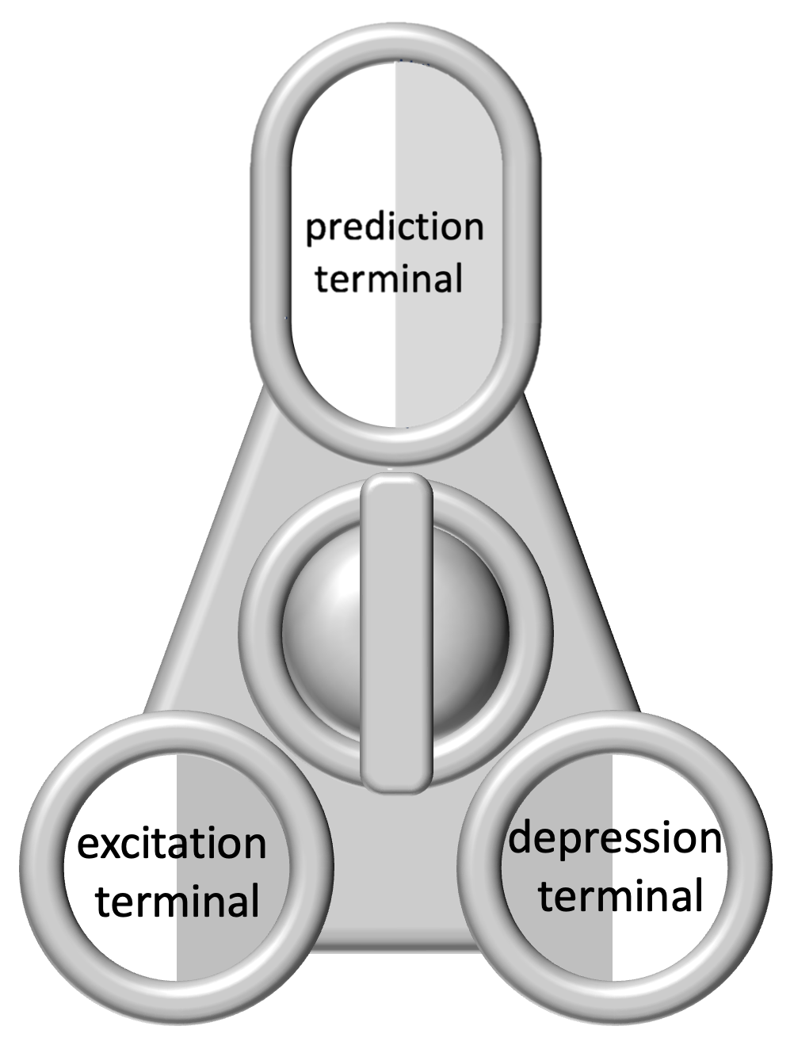
W_{p1},Θ_{p1}
W_{p2},Θ_{p2}
W_{p3},Θ_{p3}
c
c
c
c
c
c
w_{u1},Θ_{u1}
w_{d1},Θ_{d1}
w_{u2},Θ_{u2}
w_{d2},Θ_{d2}
w_{u3},Θ_{u3}
w_{d3},Θ_{d3}
f
c
f
c
f
c
y₁
y₂
y₃
c = [ y₁, y₂, y₃ ]
f

Slide 18
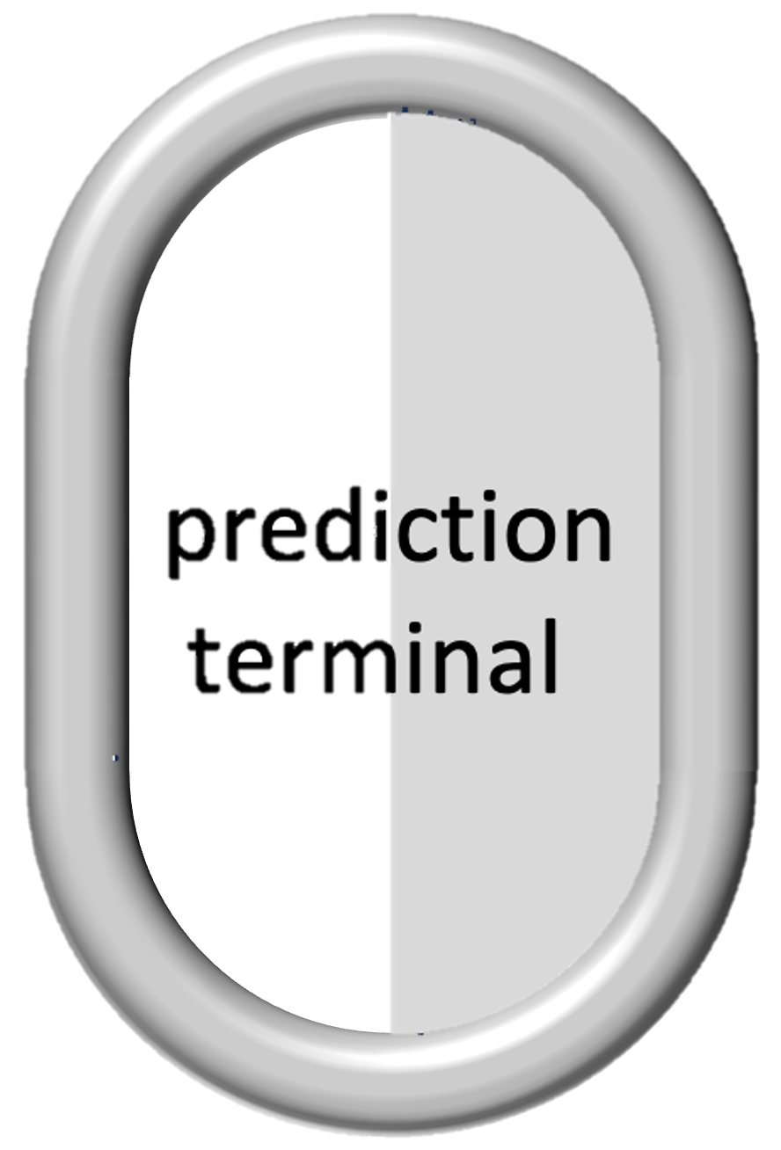

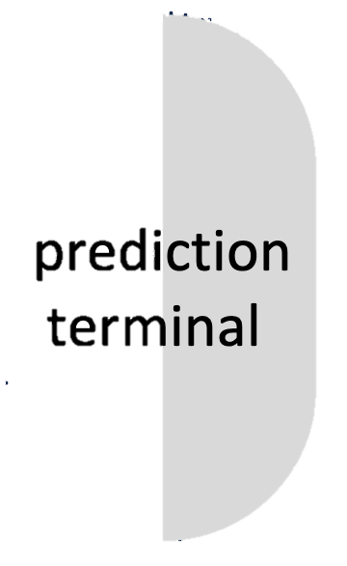

prediction
terminal
prediction
terminal
excitation
terminal
depression
terminal

Slide 19
input
1
1
0
output
a)
b)
c)
input
2
3
0
output
d)
e)
input
1
2
3
output
f)
g)

Slide 20
t = 1: Sarah
next
t = 1+T: Sarah
excite
t = 1+2T: Sarah
depress
t = 1+3T: Sarah
activate
t = 1+4T: Sarah
predict
t = 1+5T: Sarah
learn

Slide 21
t = 1: loves
next
t = 1+T: loves
excite
t = 1+2T: loves
depress
t = 1+3T: loves
activate
t = 1+4T: loves
predict
t = 1+5T: loves
learn

Slide 22
t = 2: music
next
t = 2+T: music
excite
t = 2+2T: music
depress
t = 2+3T: music
activate
t = 2+4T: music
predict
t = 2+5T: music
learn

Slide 23
t = 1.0: Sarah
t = 1.1: Sarah
t = 1.2: Sarah
t = 2.0: loves
t = 2.1: loves
t = 2.2: loves
t = 3.0: music
t = 3.1: music
t = 3.2: music

Slide 24
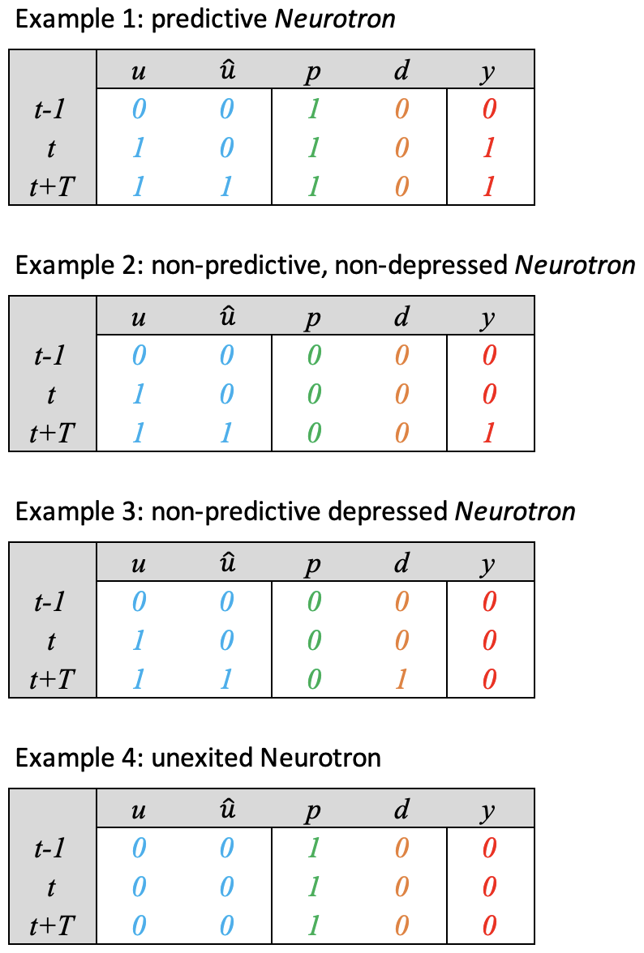
t-1
t
t+T
t-1
t
t+T
t-1
t
t+T
t-1
t
t+T
t-1
t
t+T

